Slide 1

Distributed Generative AI over Wireless Communications
Zhuoyu Yao, Yue Wang
Computer Science
Georgia State University, Atlanta, GA, USA
Apr 25, 2025
Notes:
Hello

Slide 2
Outline
Distributed Generative AI
Wireless Communications
Wireless-informed distributed Generative AI

Slide 3
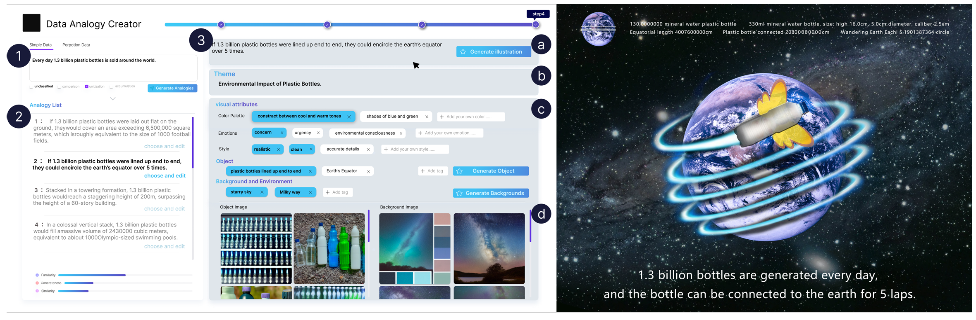
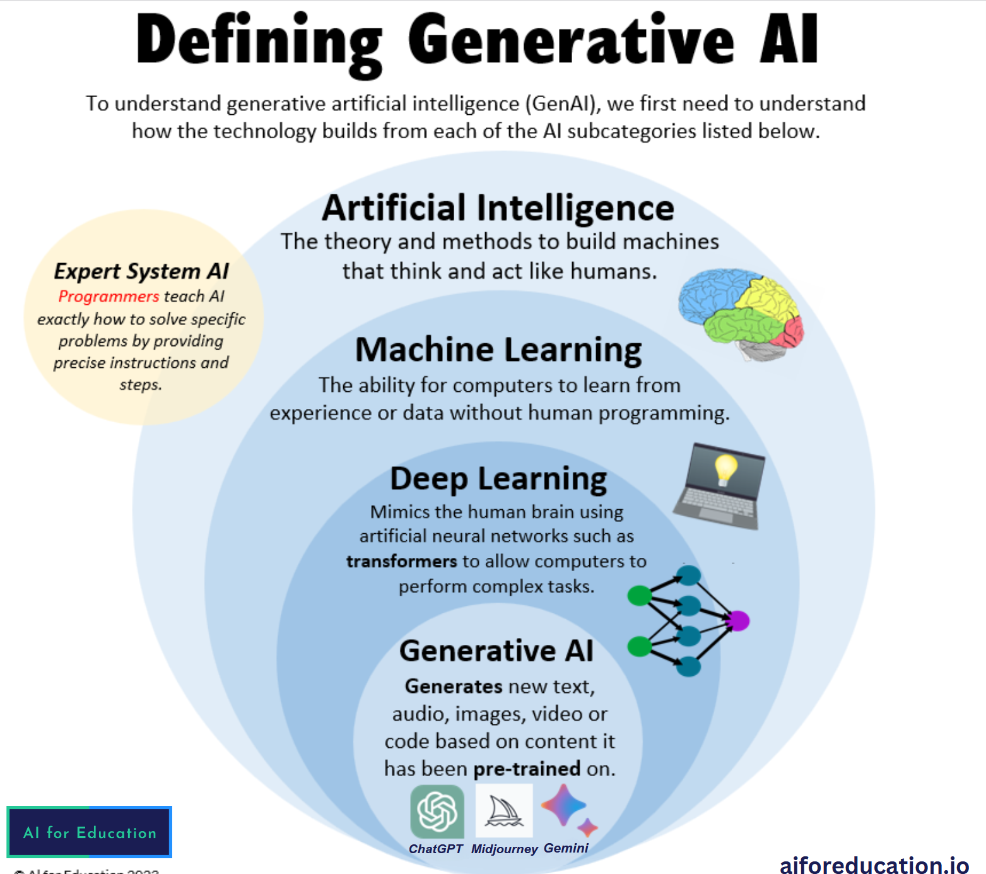
Generative AI
Generative AI
NLP: on time interpretation
Knowledge map: Wolfarm Alpha
Creative design: image generation
Bottleneck.
Data & Computational Requirements
LLaMA-2(7,13,70B) 1862GB input 16*NVIDIA A100 train 15 days 864MWh
Generalization vs. Adaptability
Privacy Concern
Bias & Fairness

Slide 4
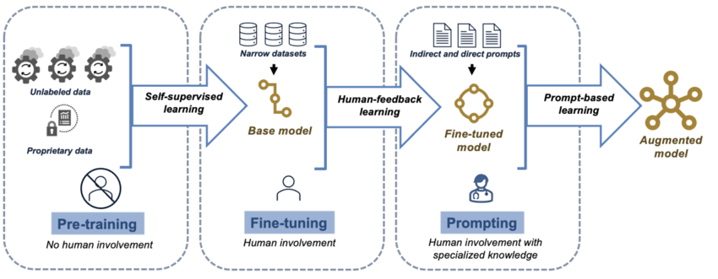
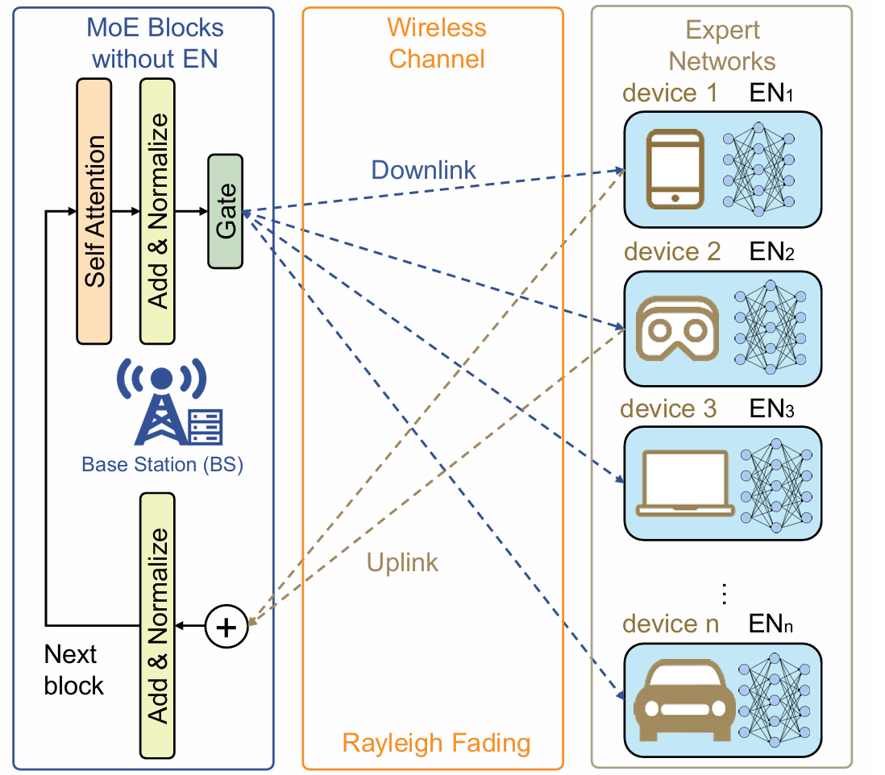

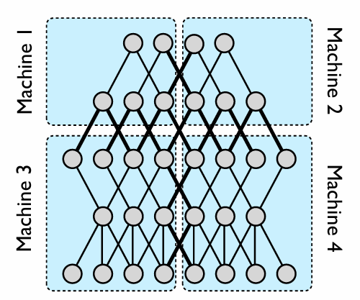
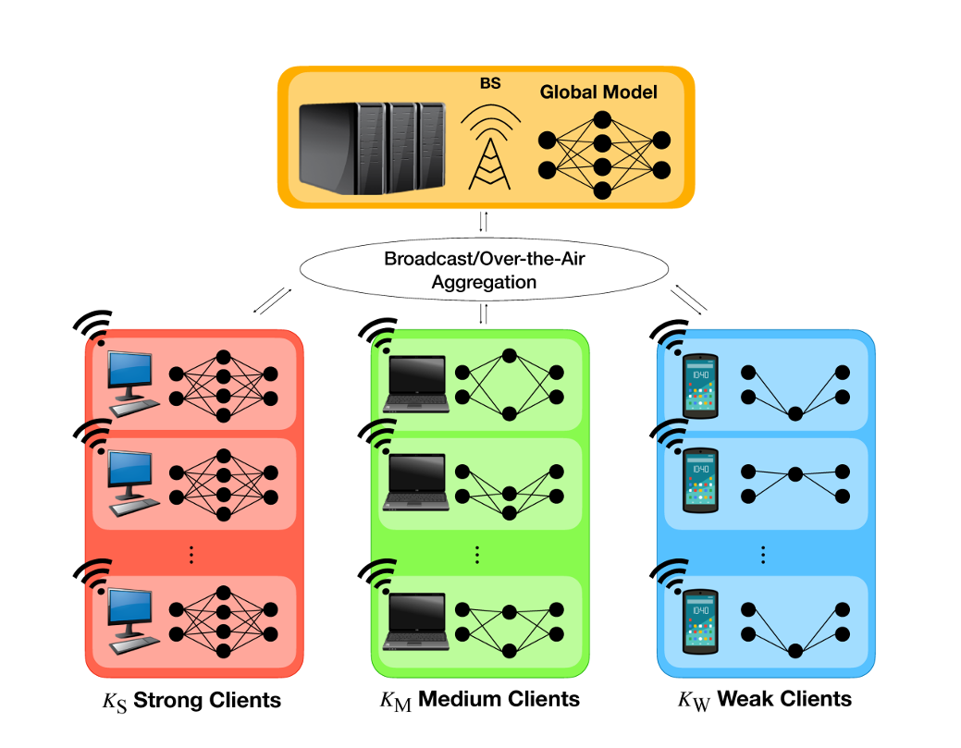
Distributed Generative AI
Resource conservation
Data privacy
Personalization
How to achieve distributed learning?
✗
Model deployment
✗
Communication Efficiency
✗
Data / devices heterogeneity

Slide 5
Why communication important?
Distributed Learning: Frequent information interaction
Large-scale data transmission
Real-time collaboration
Consistency
Things get worse in distributed generative AI^{[1]}.
Unprecedented model scale
New training paradigm
Efficiency (reducing gradient can conserve over 90% of time! ^{[2]})
Reliability & Scalability
Privacy & security
[1] Duan J, Zhang S, Wang Z, et al. Efficient training of large language models on distributed infrastructures: a survey[J]. arXiv preprint arXiv:2407.20018, 2024.
[2] Zhao Y, Liu Y, Peng Y, et al. Multi-resource interleaving for deep learning training[C]//Proceedings of the ACM SIGCOMM 2022 Conference. 2022: 428-440.

Slide 6
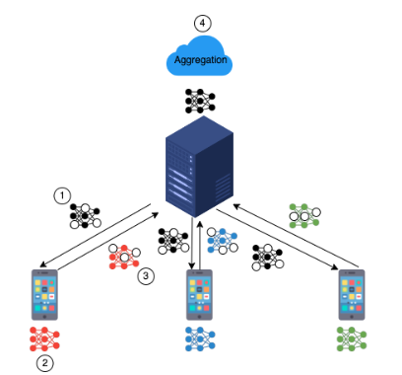
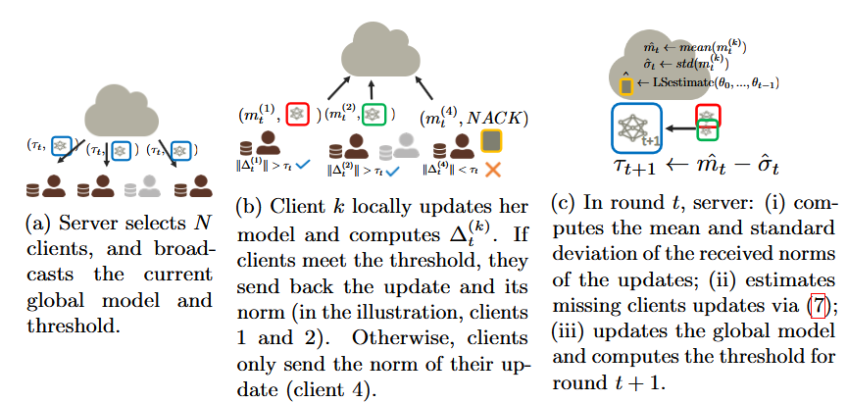
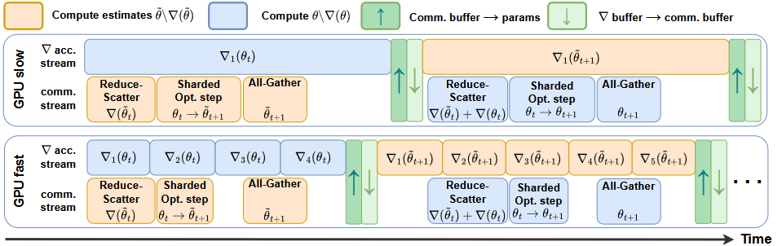
Communication Efficient Distributed Generative AI
Existing methods:
Scheduling: traffic control^{[1]}, resource optimization^{[2]}
Sparsity & compression: Sparse LoRA^{[3]}, parameter compression^{[4]}, parameter sketch^{[6]}, knowledge distillation^{[7]}
Collective communication: probabilistic selection^{[5],[8]}, over the air^{[9]}
Topology refactoring: decentralized ^{[10]}, hierarchical ^{[11]}, adaptive topological structure ^{[12]}
Scheduling
Sparse communication
Probabilistic selection
[1Jin H. Communication-Efficient Distributed LLM Training with Adaptive Traffic Control[C]//2024 IEEE International Conference on Big Data (BigData). IEEE, 2024: 8685-8687. [2] Shin M J, Hwang C, Kim J, et al. Xor mixup: Privacy-preserving data augmentation for one-shot federated learning[J]. arXiv preprint arXiv:2006.05148, 2020.
[2] Nabli A, Fournier L, Erbacher P, et al. ACCO: Accumulate while you Communicate, Hiding Communications in Distributed LLM Training[J]. arXiv preprint arXiv:2406.02613, 2024.
[3] Raje A. Communication-Efficient LLM Training for Federated Learning[D]. Carnegie Mellon University Pittsburgh, PA, 2024.
[4] Mills J, Hu J, Min G. Communication-efficient federated learning for wireless edge intelligence in IoT[J]. IEEE Internet of Things Journal, 2019, 7(7): 5986-5994.
[5] Chen M, Shlezinger N, Poor H V, et al. Communication-efficient federated learning[J]. Proceedings of the National Academy of Sciences, 2021, 118(17): e2024789118.
[6] Shah A, Chidambaram V, Cowan M, et al. {TACCL}: Guiding collective algorithm synthesis using communication sketches[C]//20th USENIX Symposium on Networked Systems Design and Implementation (NSDI 23). 2023: 593-612. [7] Wu C, Wu F, Lyu L, et al. Communication-efficient federated learning via knowledge distillation[J]. Nature communications, 2022, 13(1): 2032.
[8] Ribero M, Vikalo H. Communication-efficient federated learning via optimal client sampling[J]. arXiv preprint arXiv:2007.15197, 2020.
[9] Yang K, Jiang T, Shi Y, et al. Federated learning via over-the-air computation[J]. IEEE transactions on wireless communications, 2020, 19(3): 2022-2035.
[10] Beltrán E T M, Pérez M Q, Sánchez P M S, et al. Decentralized federated learning: Fundamentals, state of the art, frameworks, trends, and challenges[J]. IEEE Communications Surveys & Tutorials, 2023.
[11] Su L, Lau V K N. Hierarchical federated learning for hybrid data partitioning across multitype sensors[J]. IEEE Internet of Things Journal, 2021, 8(13): 10922-10939.
[12] Marfoq O, Xu C, Neglia G, et al. Throughput-optimal topology design for cross-silo federated learning[J]. Advances in Neural Information Processing Systems, 2020, 33: 19478-19487.

Slide 7
Outline
Distributed Generative AI
Wireless Communications
Wireless-informed distributed Generative AI

Slide 8
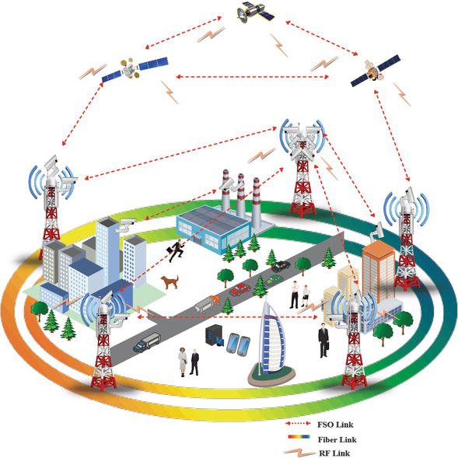
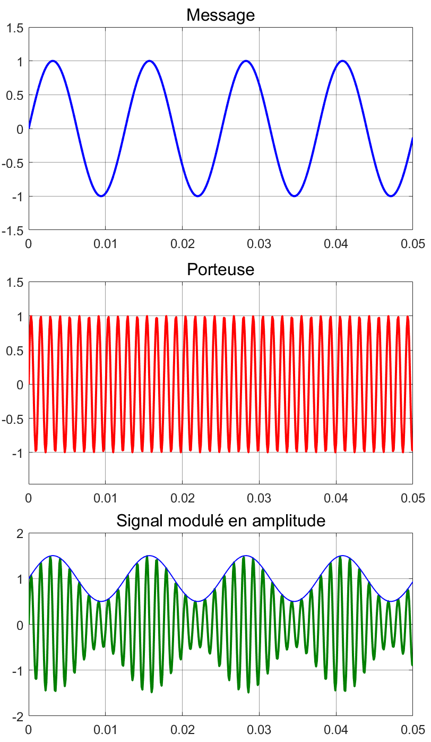
Wireless Communication
Wireless communication networks
Radio communication
Cellular communication
Satellite communications
WiFi & Bluetooth
……
Communication Link
Modulation & demodulation
efficient communication
Channel
Fading, bandwidth(throughput), path loss, shadowing
Encoder
Modulator
Wireless channel
Demodulator
Decoder
Notes:
Transmitter receiver
Why modulation? Transmit low frequency signal to high frequency to reduce the interference of other signals, achieve channel multiplexing maintain energy and
Fading: doppler shift, random fluctuations multi-path
signal distortion

Slide 9
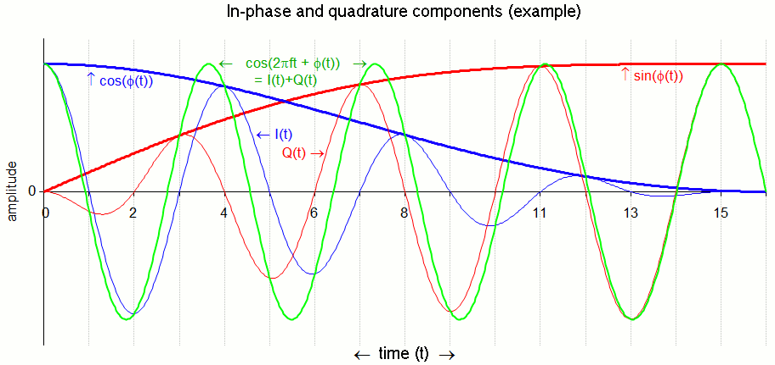
Wireless Communications – Signal Processing
In-phase and quadrature components (I/Q modulation)
Improved bandwidth utilization
Benefit in high order digital modulation (Constellation map)
Reduce sideband interference
Notes:
C reporting fraction

Slide 10
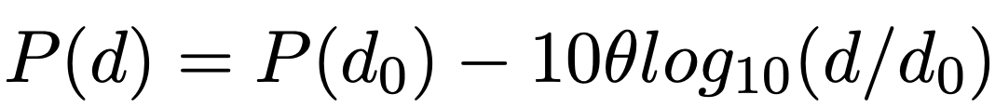
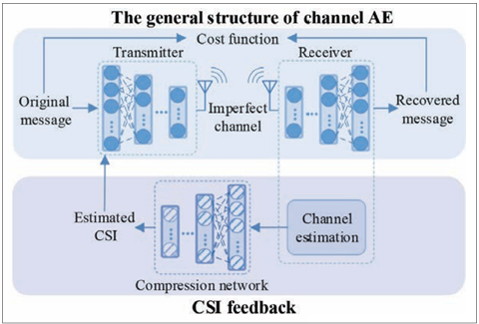
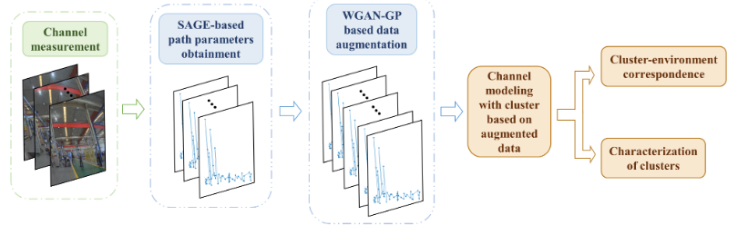
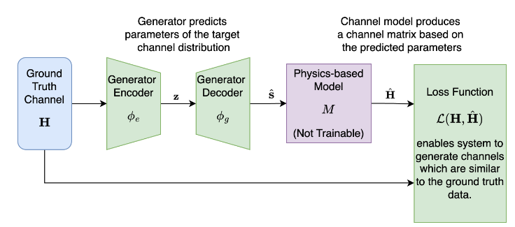
Wireless Communication – Channel Model
Key point: Quantifying the influence of wireless environments
Traditional model
Pass loss
Doppler shift (Filtered white Gaussian noise model)
Generative AI based Channel modeling
AE based channel model
Physic-inspired channel model
GAN based channel model
[1] Zou C, Yang F, Song J, et al. Channel autoencoder for wireless communication: State of the art, challenges, and trends[J]. IEEE Communications Magazine, 2021, 59(5): 136-142.
[2] Wagle S, Malhotra A, Hamidi-Rad S, et al. Physics-Informed Generative Approaches for Wireless Channel Modeling[J]. arXiv preprint arXiv:2503.05988, 2025.
[3] Zhang X, Liu Y, Zhou S, et al. GAN-Based Channel Generation and Modeling for 6G Intelligent IIoT Communications[J]. IEEE Internet of Things Journal, 2025.

Slide 11
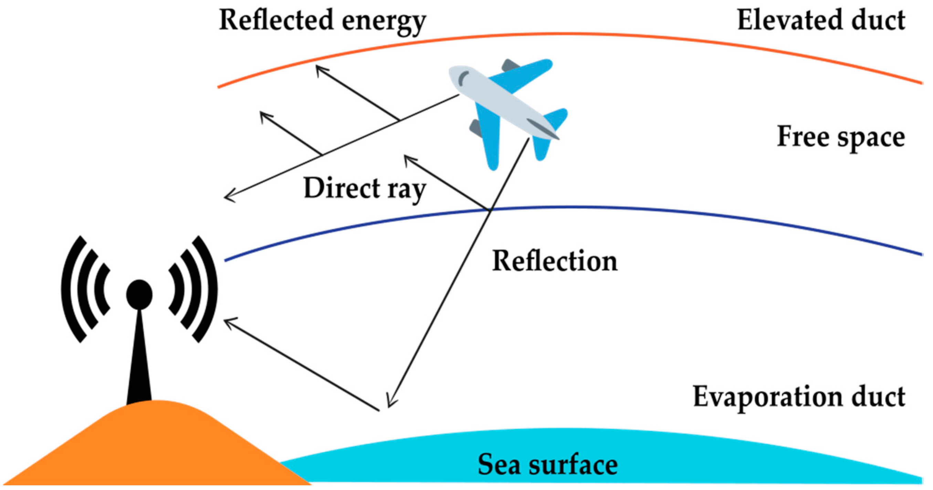

Wireless Communication – Channel Multiplexing
Orthogonal frequency-division multiplexing（OFDM for 4G and 5G）
If the bandwidth of signal is lager than the channel bandwidth, the transmitted signal will be distorted
OFDM: separate the carrier wave into orthogonal sub-wave
High spectral efficiency
Robust against co-channel interference
Efficient implementation FFT
[1] Kairouz P, McMahan H B, Avent B, et al. Advances and open problems in federated learning[J]. Foundations and trends® in machine learning, 2021, 14(1–2): 1-210.
Notes:
Wide bandwidth signal transmission

Slide 12


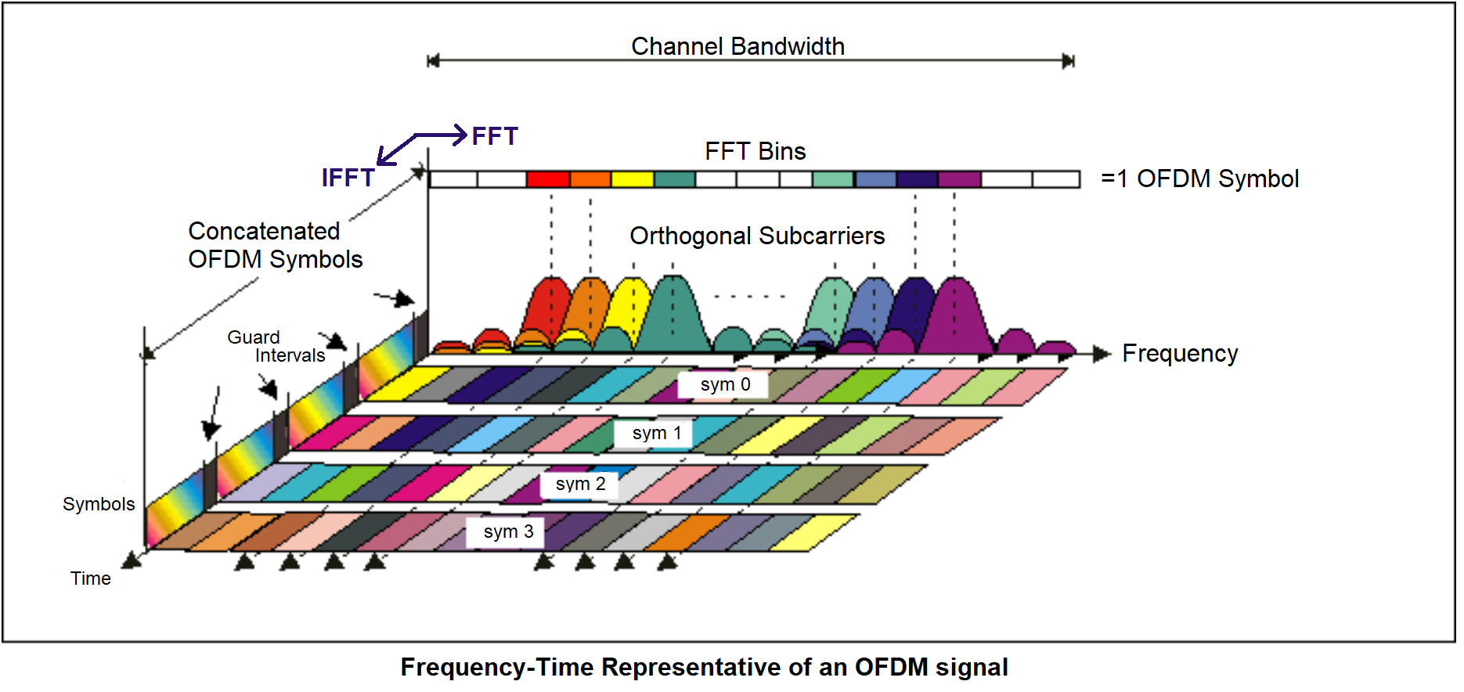
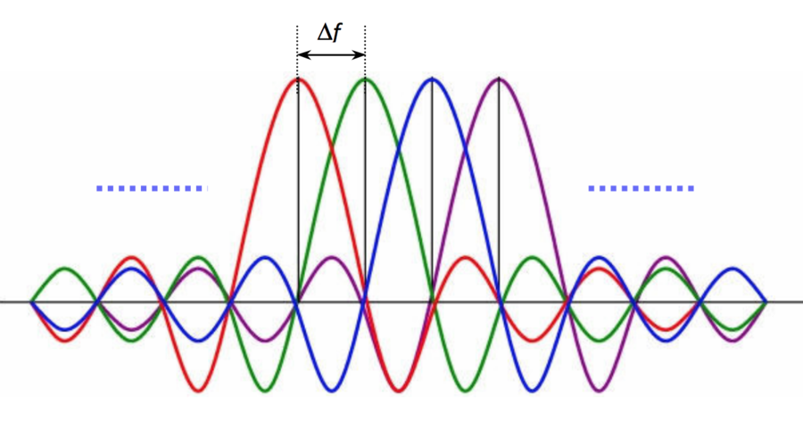
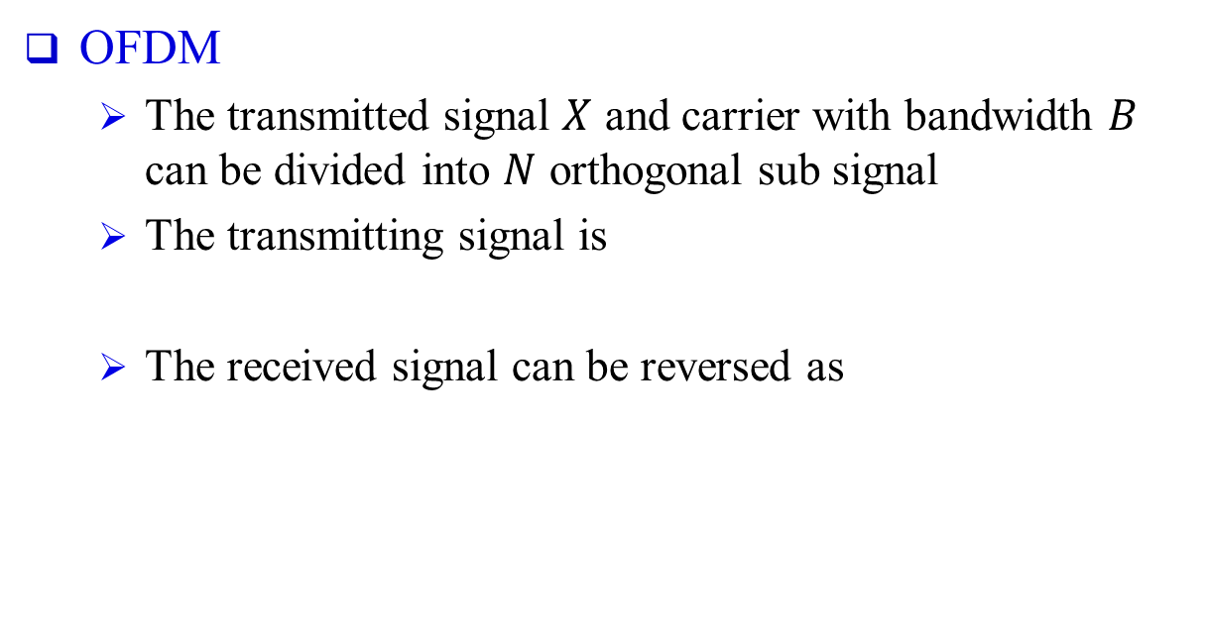
Wireless Communication – Channel Multiplexing
OFDM
The transmitted signal $X$ and carrier with bandwidth $B$ can be divided into $N$ orthogonal sub signal
The transmitting signal is
The received signal can be reversed as
Notes:
Select orthogonal

Slide 13
Wireless Communication – Metrics
Signal-to-Noise Ratio (SNR)
Bit Error Rate (BER)
Throughput
Latency
Transmission latency
Processing latency
Notes:
packet error ratio

Slide 14
Outline
Distributed Generative AI
Wireless Communications
Wireless-informed distributed Generative AI

Slide 15
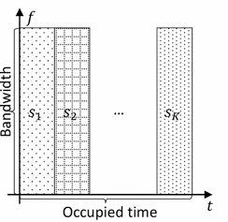
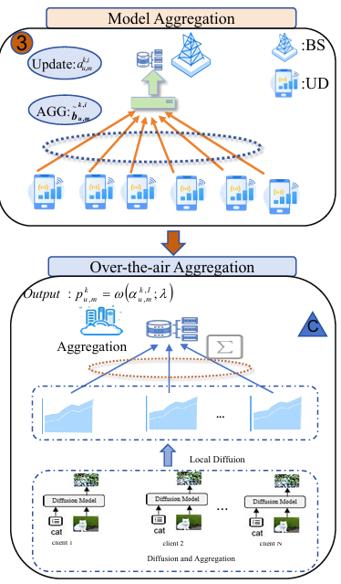
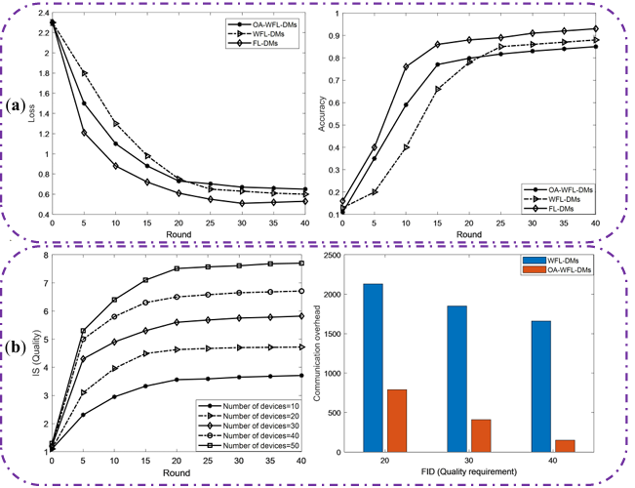
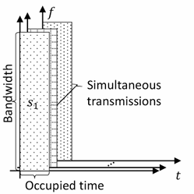
Efficiency: Multiple access channel
Multiple access channel
Allow over the air analog aggregation of via simultaneous transmission
Communication efficiency:
[1] Şahin A, Yang R. A survey on over-the-air computation[J]. IEEE Communications Surveys & Tutorials, 2023, 25(3): 1877-1908..
[2] Zheng J, Niyato D, Zhang H, et al. Over-the-air Wireless Federated Learning Model for Generative AI[J]. IEEE Network, 2025.
Notes:
Covariate shift the distribution is different between train set and test set
Prior probability shift the labels is different between train set and test set
Concept shift the mapping function is different between train set and test set

Slide 16
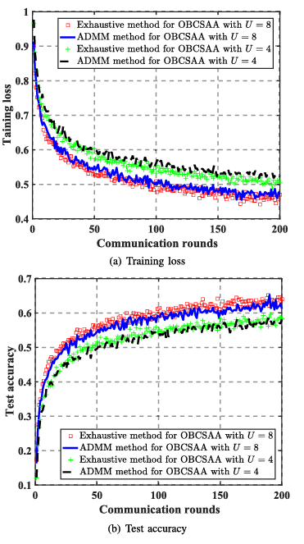





Efficiency: One bit Compressive Sensing
Communication efficiency:
Algorithm
Top-k Sparsification
Dimensionality Reduction
Quantization
Analog Aggregation Transmission
Reconstruction
[1] Fan X, Wang Y, Huo Y, et al. 1-bit compressive sensing for efficient federated learning over the air[J]. IEEE transactions on wireless communications, 2022, 22(3): 2139-2155.
Notes:
Covariate shift the distribution is different between train set and test set
Prior probability shift the labels is different between train set and test set
Concept shift the mapping function is different between train set and test set

Slide 17
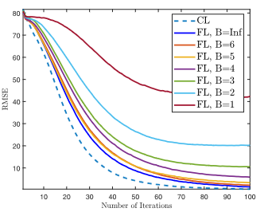
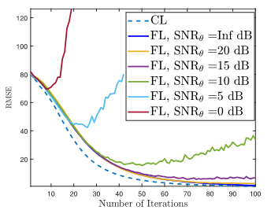
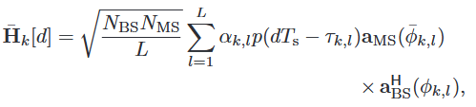
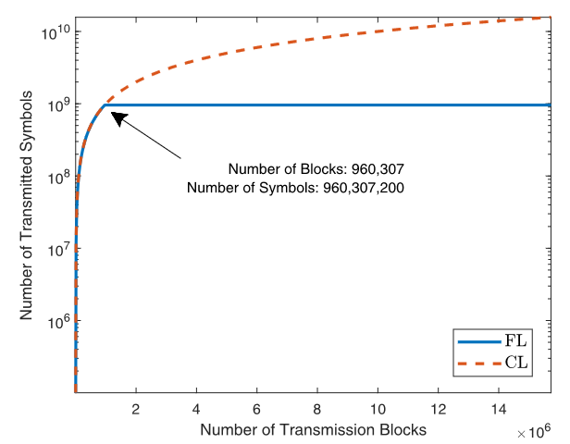



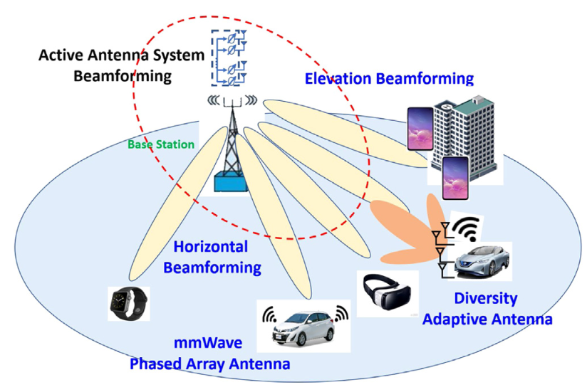
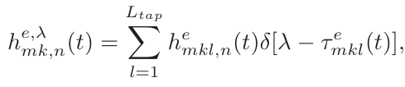
Reliability: Channel Modeling
Key point: make the channel model more reliable.
D-delayed MIMO channel. ^{[1]}
Time-varying channel： impulse response of ODFM
[1] Elbir A M, Coleri S. Federated learning for channel estimation in conventional and RIS-assisted massive MIMO[J]. IEEE transactions on wireless communications, 2021, 21(6): 4255-4268..
[2] Ma Z, Liu Y, Miao Y, et al. Flgan: Gan-based unbiased federated learning under non-iid settings[J]. IEEE Transactions on Knowledge and Data Engineering, 2023, 36(4): 1566-1581.
Notes:
base station for k users
complex path gain \ALPHA
d time delay
Tau corresponding time delay
p pulse shaping function
A antenna array
Lambda single operator wavelength
F beamformer
D_bs is the length of antenna

Slide 18
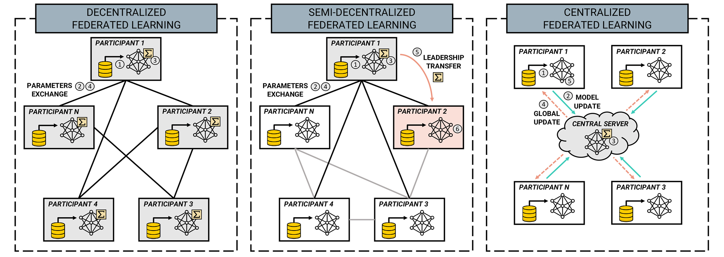
Inspiration & Future works
Decentralized distributed learning framework： Adaptive topological
stochastic communication channel
collaborative learning scheme (Maximum independent set)
Wireless inspired communication model (why we need 1 bit transmission?)

Slide 19
Thank You!

